Slide 1
STOCK TICKER SPRINT II
Nirds:
Patrick Gallagher,
Spencer Russell,
Tianyi Zhang,
Hank Zhu

Slide 2
Overview of Sprint 2
Connecting API to the every file of the project.
Making the user-interface looks better.
Displaying the graph based on hours, days, and months.
Integrating the search function to the detailed stock information panel.

Slide 3
User Stories
As a user, I want multiple data displays when I am looking at a stock. So that I can have an easier time looking at a stock.
As a user, I want a search function when looking for stocks to add, so that I can find stocks easier.
As an investor, I want to keep hold of my personal shares. So that I can monitor my own financial gain.

Slide 4
Implementing the Data
We are not using a database, but a text file that has all of the stock names
Each class can be connected to the API that can get the stock information

Slide 5
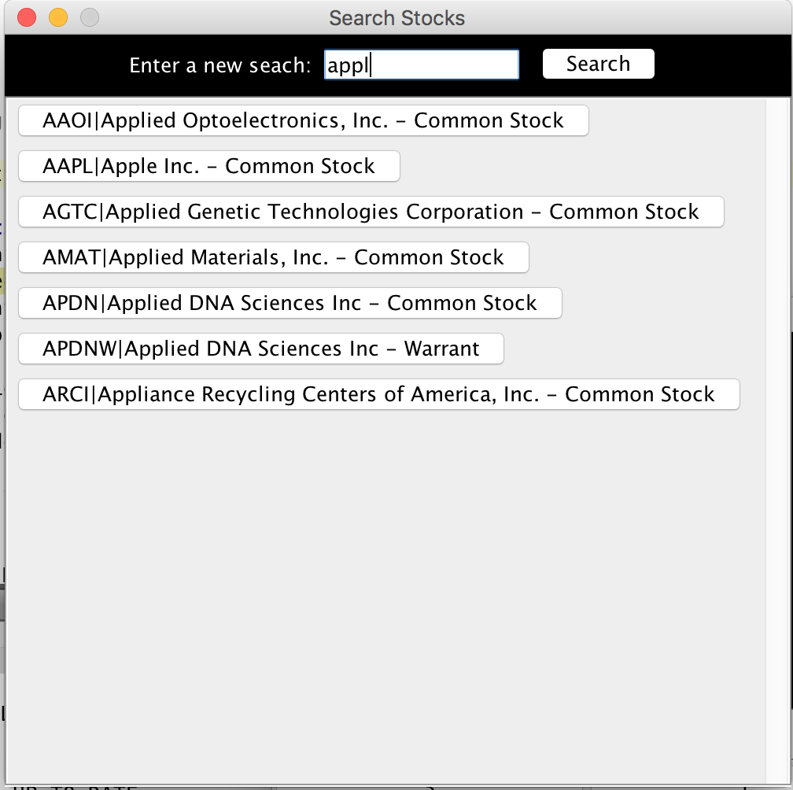
Search Stocks
Read stock information from stock database that extracted from API
“For” loop keep examining whether the stocks matches the user-input or not
Shows all the stocks that contains the keywords of the user-input.

Slide 6

Storing Stocks
The “add/remove” button was given partial functionality , when prompted it examines a .txt file of stock names
If the stock is encountered in the list, it will be removed
Else , the stock will be added to the list
Future sprints will connect the text file and other frames to display the user’s stocks

Slide 7
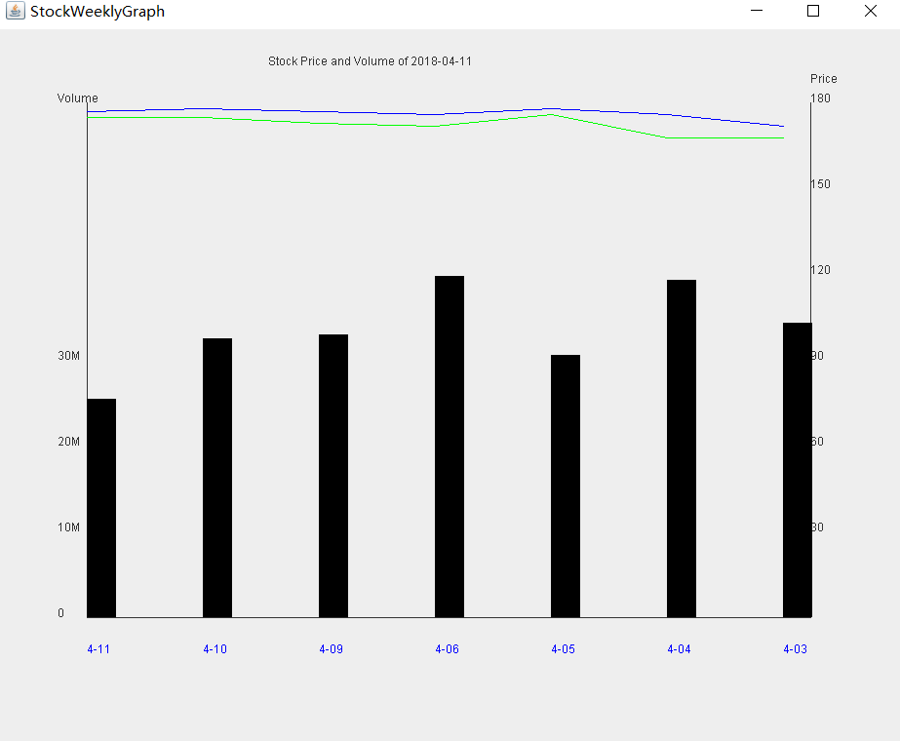
StockWeeklyGraph

Slide 8
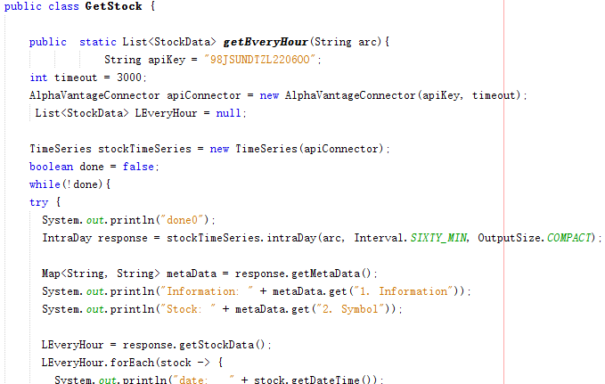
GetStock.java

Slide 9
Next Sprint
Add help function for the application.
Add a password for the application.
Add the comparison function, the same stock from two different years.
Starting to debug and make the program look nicer than it is now.

